Slide 1

Clinical Practice Guidelines for Quality Palliative Care,
4th edition

Slide 2
Objectives
Define palliative care.
Explain how the 4th edition of the National Consensus Project’s Clinical Practice Guidelines for Quality Palliative Care (NCP Guidelines) was developed.
Describe the eight domains of the NCP Guidelines and what’s new in the 4th edition.
Identify strategies to implement the NCP Guidelines within your health care team and organization.
Notes:
The learning objectives are:
Define palliative care. (Note: the NCP definition will be discussed in this presentation)
Explain how the 4th edition of the National Consensus Project’s Clinical Practice Guidelines for Quality Palliative Care (NCP Guidelines) was developed.
Describe the eight domains of the NCP Guidelines and what’s new in the 4th edition.
Identify strategies to implement the NCP Guidelines within your health care team and organization.

Slide 3
What is Palliative Care?
Notes:
To begin, let’s review and discuss the definition of palliative care and other key concepts to better understand the context of the guidelines.

Slide 4
Palliative Care Definition
Interdisciplinary care delivery system designed for patients, their families and caregivers
Beneficial at any stage of a serious illness
Anticipates, prevents, and manages physical, psychological, social, and spiritual suffering to optimize quality of life
Delivered in any care setting through the collaboration of many types of care providers
Improves quality of life for both the patient and the family through early integration into the care plan
- National Consensus Project for Quality Palliative Care
Notes:
(Note: the definition of ‘Palliative Care’ is located in the ‘Foreword’ of the NCP Guidelines, page ii)
National Consensus Project for Quality Palliative Care defines palliative care as follows:
Beneficial at any stage of a serious illness, palliative care is an interdisciplinary care delivery system
designed to anticipate, prevent, and manage physical, psychological, social, and spiritual suffering to
optimize quality of life for patients, their families and caregivers. Palliative care can be delivered in
any care setting through the collaboration of many types of care providers. Through early integration
into the care plan of seriously ill people, palliative care improves quality of life for both the patient
and the family.

Slide 5

Key Concepts
Person-and family-centered approach to care
Inclusive of all people living with serious illness, regardless of setting, diagnosis, age or prognosis
A responsibility of all clinicians and disciplines caring for people living with serious illness
Notes:
The new edition of the NCP Guidelines expands upon the content in the 3rd edition, and specifically focuses on the following key concepts:
Palliative care is a person and family centered approach to care.
Palliative care is inclusive of all people with serious illness, regardless of setting, diagnosis, prognosis, or age. As a result, language specific to the care of neonates, children, and adolescents was emphasized throughout the NCP Guidelines.
Timely consideration of palliative care is the responsibility of clinicians and disciplines caring for the seriously ill, including primary care practices, specialist care practices (eg, oncology or neurology), hospitalists, nursing home staff, and palliative care specialist teams such as hospice, hospital and community-based palliative care teams.

Slide 6

Serious Illness
A health condition that carries a high risk of mortality and either negatively impacts a person’s daily function or quality of life or excessively strains their caregiver.*
*Kelley, AS, Bollens-Lund, E. Identifying the population with serious illness: the “denominator” challenge. Journal of Palliative Medicine. Volume: 21 Issue S2: March 1, 2018.
Notes:
This is the definition of ‘Serious Illness’ that is used in the 4th edition of the NCP Guidelines that was published by Drs. Kelly and Bollens-Lund.

Slide 7
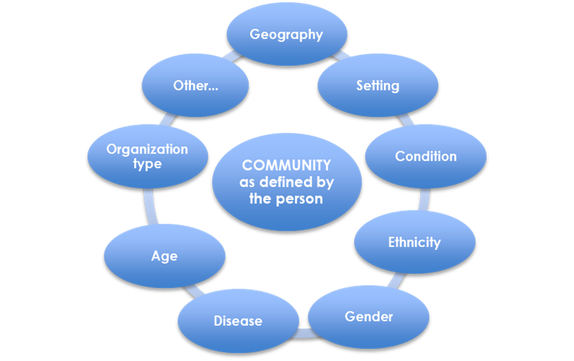
Community is Person-Centric
“Community” is defined:
  by the person living with serious illness
  as a lens through which their needs are assessed
- National Consensus Project Strategic Directions Summit June 2017
Notes:
One of the strategic outcomes of the National Stakeholder Summit that was held in June 2017 before the actual writing of the 4th edition began, was the person-centric definition of community that was established. “Community” in the context of the NCP Guidelines is defined by the person; however, needs can change based on the setting of care and other factors (e.g. in the ICU, home, etc.). It is also helpful to define community as a lens through which people’s needs can be assessed. Community is person-centric and should not be “medicalized.”

Slide 8
Guidelines Background & Process
Notes:
This section is to provide more information about the NCP Guidelines background and development process.

Slide 9
Why Clinical Practice Guidelines?
Guidelines improve care and safety for patients and families:
  Defines structures and processes of care
  Sets expectations for providers
  Guides clinical decision making
  Promotes standardization
  Creates a foundation for accountability
Guidelines provide the essential elements for standards, policies and best practices
Notes:
The purpose of clinical practice guidelines are to improve care and safety of patients and their families. Specifically, the guidelines serve to:
Define structures and processes of care
Set expectations for providers
Guide clinical decision making
Promote standardization
Create a foundation for accountability
Clinical practice guidelines provide the essential elements for standards, polices and best practices – and should not be confused as standards of care. Guidelines provide high-level recommendations for quality care and standards provide the specific guidance for how to deliver quality care.

Slide 10

National Consensus Project for Quality Palliative Care (NCP)
Began in 2001 to define and improve the delivery of palliative care
Stakeholder involvement expanded over the last decade
Three prior editions of the NCP Guidelines published: 2004, 2009, 2013
National Coalition for Hospice and Palliative Care serves as organization home of NCP
Notes:
The National Consensus Project for Quality Palliative Care (NCP) began in 2001 with a task force of five key national organizations and content experts. The purpose of the NCP is to further define and underscore the value of palliative care, and improve upon the delivery of palliative care in the United States. The NCP expanded over that last decade to include more national organizations and stakeholders. Three prior editions of the NCP Guidelines were published in 2004, 2009, and 2013. The National Coalition for Hospice and Palliative Care serves as the organizational home of the NCP.

Slide 11
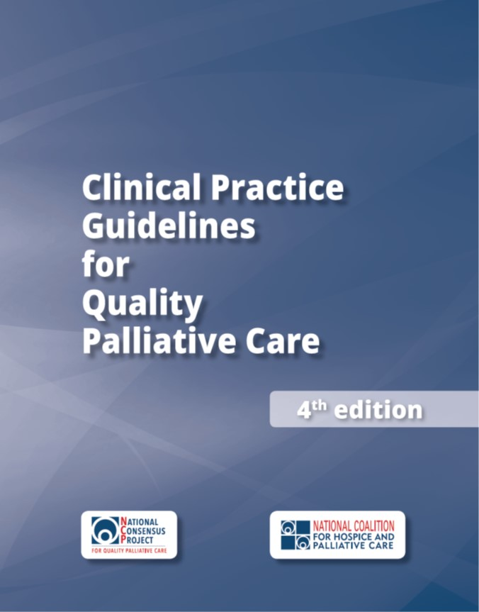
The 4th edition
For all people with serious illness, regardless of setting, diagnosis, prognosis, or age
Funded by the Gordon and Betty Moore Foundation
Published by the National Coalition for Hospice and Palliative Care
NCP leadership consisted of 16 national organizations
Notes:
The 4th edition of the NCP Guidelines was greatly expanded to improve access to quality palliative care for all people with serious illness, regardless of setting, diagnosis, prognosis, or age. This edition is for all clinicians who care for seriously ill patients, and not just for palliative care specialists. The 4th edition provides the essential elements of what all clinicians (specialists and primary care) can do to provide quality palliative care. The development and dissemination of this edition was funded by the Gordon and Betty Moore Foundation and published by the National Coalition for Hospice and Palliative Care. The leadership for the 4th edition consisted of 16 national organizations in addition to the Coalition staff and the NCP writer/editor.

Slide 12















NCP Leadership Organizations
National Pediatric Hospice and Palliative Care Collaborative
Notes:
These are the 16 national organizations who provided the leadership of the National Consensus Project to develop the 4th edition. Each organization provided representatives to serve on the NCP Steering Committee and NCP Writing Workgroup.

Slide 13
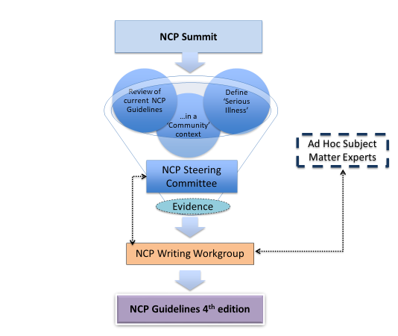
National Consensus Project Process (2017-18)
Development:
  Steering Committee and Writing Workgroup formed
  NCP Strategic Directions Stakeholder Summit held
  Writing > reviews > revisions > approvals > consensus achieved
Systematic review of research evidence:
  Completed by the RAND Evidence-based Practice Center
Endorsements:
  Received from more than 80 national organizations
Publication: October 31, 2018
Notes:
This slide provides a visual overview of how the 4th edition was developed. Interesting to note, the original goal and intent was to develop guidelines for community-based palliative care. When this project was officially launched with a National Stakeholder Strategic Directions Summit, a key decision was made have one unified set of guidelines that would serve to improve quality palliative care for all people living with serious illness regardless of setting, age, diagnosis, or prognosis.
From that point, the actual writing, reviews, revisions, approval, and consensus process was a year-long effort.
Also, a systematic review of the research evidence was added to the original project scope and conducted by the RAND corporation that will be highlighted later in this presentation.
Before the guidelines were published, more than 80 national organizations endorsed the guidelines which are listed in the Appendix section of the guidelines and on the NCP website.
The 4th edition was officially published on Oct. 31, 2018.

Slide 14
4th edition: Domains & Content
Notes:
Now, would like to discuss the specific domains and content of the 4th edition – and specifically point out ‘what’s new’ and key revisions made in the new edition for reach domain.

Slide 15
Domains of Palliative Care
Domain 1: Structure and Processes of Care
Domain 2: Physical Aspects of Care
Domain 3: Psychological and Psychiatric Aspects of Care
Domain 4: Social Aspects of Care
Domain 5: Spiritual, Religious, and Existential Aspects of Care
Domain 6: Cultural Aspects of Care
Domain 7: Care of the Patient Nearing the End of Life
Domain 8: Ethical and Legal Aspects of Care
Notes:
The NCP Guidelines, 4th edition, are organized into 8 domains which are the same domains featured in the previous editions.
Domain 1 is Structure and Processes of Care. The composition of an interdisciplinary team is outlined, including the professional qualifications, education, training, and support needed to deliver optimal patient- and family-centered care. Domain 1 also defines the elements of the palliative care assessment and care plan, as well as systems and processes specific to palliative care.
Domain 2 is Physical Aspects of Care. The palliative care assessment, care planning, and treatment of physical symptoms are described, emphasizing patient- and family-directed holistic care.
Domain 3 is Psychological and Psychiatric Aspects of Care. The domain focuses on the processes for systematically assessing and addressing the psychological and psychiatric aspects of care in the context of serious illness.
Domain 4 is Social Aspects of Care. This domain outlines the palliative care approach to assessing and addressing patient and family social support needs.
Domain 5 is the Spiritual, Religious, and Existential Aspects of Care. The spiritual, religious, and existential aspects of care are described, including the importance of screening for unmet needs.
Domain 6 is Cultural Aspects of Care. The domain outlines the ways in which culture influences both palliative care delivery and the experience of that care by the patient and family, from the time of diagnosis through death and bereavement.
Domain 7 is Care of the Patient Nearing the End of Life. Note there was a name change of this domain from the 3rd edition, which was titled: Care of the Patient AT the End of Life. This domain focuses on the symptoms and situations that are common in the final days and weeks of life.
Domain 8 is Ethical and Legal Aspects of Care. Content includes advance care planning, surrogate decision-making, regulatory and legal considerations, and related palliative care issues, focusing on ethical imperatives and processes to support patient autonomy.

Slide 16

Key Themes: the 6 C’s
Each domain addresses:
  Comprehensive assessment
  Care coordination
  Care transitions
  Caregiver needs
  Cultural inclusion
  Communication
Notes:
The 4th edition was expanded to address the following key themes (the 6 C’s) that were integrated into all eight domains:
• The elements of a comprehensive assessment are described;
• Family caregiver assessment, support, and education are referenced;
• The essential role of care coordination, especially during care transitions, is emphasized;
• Culturally inclusive care is referenced in all the domains and expanded in the Cultural Aspects of
Care domain; and
• Communication (within the palliative care team, with patients and families, with other clinicians, and with community resource providers) is a prerequisite for delivery of quality care for the seriously ill and is emphasized throughout.

Slide 17

Domain 1: Structure and Processes of Care
Principles and practices can be integrated into any health care setting
Delivered by all clinicians and supported by palliative care specialists who are part of an interdisciplinary team (IDT)
Begins with a comprehensive assessment and emphasizes:
  Patient and family engagement
  Communication
  Care coordination
  Continuity of care across health care settings
Notes:
Now will provide an overview of each domain in the 4th edition and what’s new from the 3rd edition. (SEE SPEAKER NOTES RE: KEY REVISIONS IN EACH DOMAIN SLIDE)
Domain 1: Structures and Processes of Care states that palliative care principles and practices can be integrated into any health care setting, delivered by all clinicians and supported by palliative care specialists who are part of an interdisciplinary team (IDT) with the professional qualifications, education, training, and support needed to deliver optimal patient- and family-centered care. Palliative care begins with a comprehensive assessment and emphasizes patient and family engagement, communication, care coordination, and continuity of care across health care settings.
Key revisions in Domain 1: Structures and Processes of Care include:
Coordination of care is emphasized as an important element of care, especially when patients receive community-based palliative care. New content regarding the need for ongoing sustainability is included.

Slide 18

Domain 2: Physical Aspects of Care
Begins with understanding patient goals in the context of physical, functional, emotional, and spiritual
Focuses on relieving symptoms and improving or maintaining functional status and quality of life
Emphasizes symptom management that encompasses pharmacological, non-pharmacological, interventional, behavioral, and complementary treatments
Is accomplished through collaboration between all professionals involved in the patients’ care across all care settings
Notes:
Domain 2 states Physical Aspects of Care of seriously ill patients begins with an understanding of the patient goals in the context of their physical, functional, emotional, and spiritual well-being. The assessment and care plan focus on relieving symptoms and improving or maintaining functional status and quality of life. The management of symptoms encompasses pharmacological, non-pharmacological, interventional, behavioral, and complementary treatments. Physical care, acute and chronic symptom management across all care settings is accomplished through communication, collaboration, and coordination between all professionals involved in the patients’ care, including primary and specialty care providers.
Key revisions in Domain 2: Physical Aspects of Care, include:
Recognizing advances in the field, the importance of validated tools to assess and manage pain and other symptoms is highlighted. The impact of functional status on quality of life is also emphasized.

Slide 19

Domain 3: Psychological and Psychiatric Aspects of Care
IDT addresses psychological and psychiatric aspects of care in the context of serious illness
IDT conducts comprehensive developmentally and culturally sensitive mental status screenings
Social worker facilitates mental health assessment and treatment in all care settings
IDT communicates to the patient and family the implications of psychological and psychiatric aspects of care
Notes:
Domain 3: Psychological and Psychiatric Aspects of Care states the palliative care interdisciplinary team (IDT) systematically addresses psychological and psychiatric aspects of care in the context of serious illness. The IDT conducts comprehensive developmentally and culturally sensitive mental status screenings of seriously ill patients. The social worker facilitates mental health assessment and treatment in all care settings, either directly, in consultation, or through referral to specialist level psychological and/or psychiatric care. The IDT communicates to the patient and family the implications of psychological and psychiatric aspects of care in establishing goals of care and developing a treatment plan, addressing family conflict, delivering grief support and resources from the point of diagnosis onward, and providing referrals for patients or family members who require additional support.
Key revisions in Domain 3: Psychological and Psychiatric Aspects of Care, include:
The responsibilities of the social worker and all palliative care clinicians are clarified and strengthened regarding the mental health assessment and treatment in all care settings, either directly, in consultation, or through referral to specialist level psychological and/or psychiatric care. Since community-based clinicians may not have adequate access to specialist level psychological and/or psychiatric care, the teams’ responsibilities to patients and families is highlighted. Grief and bereavement are described separately to reflect the distinction between the two concepts; bereavement is now in Domain 7, which focuses on care nearing the end of life.

Slide 20

Domain 4: Social Aspects of Care
Addresses environmental and social factors that affect patients and their families
Social determinants of health have a strong influence on care outcomes
IDT partners with the patient and family to identify strengths and address needs
Social worker is essential to the IDT
Notes:
Domain 4: Social Aspects of Care calls out that social determinants of health, (the “social factors”) have a strong and sometimes overriding influence on patients with a serious illness. Palliative care addresses environmental and social factors that affect patient and family functioning and quality of life. The palliative care interdisciplinary team (IDT) partners with the patient and family to identify and support their strengths and to address areas of need. The IDT includes a social worker to maximize patient functional capacity and achieve patient and family goals.
Key revisions in Domain 4: Social Aspects of Care include:
An assessment of social supports, relationships, practical resources, and safety and appropriateness of the care environment.

Slide 21

Domain 5: Spiritual, Religious, and Existential Aspects of Care
Spirituality is recognized as a fundamental aspect of palliative care
Dynamic aspect through which individuals seek meaning, purpose, and transcendence, and experience relationships
Expressed through beliefs, values, traditions, and practices
IDT serves in a manner that respects
  all spiritual beliefs and practices, and
  when patients and families decline to discuss their beliefs or accept support
Notes:
In Domain 5: Spiritual, Religious, and Existential Aspects of Care, Spirituality is recognized as a fundamental aspect of compassionate, patient and family-centered palliative care.
It is a dynamic and intrinsic aspect of humanity through which individuals seek meaning, purpose, and transcendence, and experience relationship to self, family, others, community, society, and the significant or sacred. Spirituality is expressed through beliefs, values, traditions, and practices. Palliative care interdisciplinary teams (IDT) serve each patient and family in a manner that respects their spiritual beliefs and practices. Teams are also respectful when patients and families decline to discuss their beliefs or accept spiritual support.
Key revisions in Domain 5: Spiritual, Religious and Existential Aspects of Care, include:
The responsibility of all clinicians serving the seriously ill is outlined to assess and respond to spiritual care needs, emphasizing the need for training for spiritual care providers to care for patients and families. Flexible approaches to ensuring adequate spiritual support of patients and families are described.

Slide 22

Domain 6: Cultural Aspects of Care
First step is assessing and respecting values, beliefs and traditions
Care plans incorporate culturally sensitive resources and strategies
Respectful acknowledgment and culturally sensitive support for grieving practices is provided
IDT members continually expand awareness of their own biases and perceptions
Notes:
Domain 6: Cultural Aspects of Care notes that assessing and respecting values, beliefs and traditions related to health, illness, family caregiver roles and decision-making are the first step in providing culturally sensitive palliative care. Palliative care interdisciplinary team (IDT) members continually expand awareness of their own biases and perceptions about race, ethnicity, gender identity and gender expression, sexual orientation, immigration and refugee status, social class, religion, spirituality, physical appearance, and abilities.
Information gathered through a comprehensive assessment is used to develop a care plan that incorporates culturally sensitive resources and strategies to meet the needs of patients and family members. Respectful acknowledgment of and culturally sensitive support for patient and family grieving practices is provided.
Key revisions in Domain 6: Cultural Aspects of Care, include:
Specific elements of a cultural assessment are outlined. The influence of culture within families is delineated, with specific attention to the role of the child or adolescent in treatment decisions. The conscious practice of cultural humility is also emphasized.

Slide 23

Domain 7: Care of the Patient Nearing the End of Life
Highlights care provided to patients and their families near the end of life,
Particular emphasis on the days leading up to and just after the death of the patient.
Comprehensive assessment and management of physical, social, spiritual, psychological, and cultural aspects of care are critically important near death
IDT provides developmentally appropriate education to patient, family and others
Notes:
Domain 7: Care of the Patient Nearing the End of Life highlights the care provided to patients and their families near the end of life, with a particular emphasis on the days leading up to and just after the death of the patient. The meticulous and comprehensive assessment and management of pain and other physical symptoms, as well as social, spiritual, psychological, and cultural aspects of care, are critically important as the patient nears death. It is essential that the interdisciplinary team (IDT) ensures reliable access and attention in the days before death, and provides developmentally appropriate education to the patient, family and/or other caregivers about what to expect near death, as well as immediately following the patient’s death. (SEE NEXT SLIDE TO CONTINUE DOMAIN 7)

Slide 24

Domain 7: Care of the Patient Nearing the End of Life (continued)
Interdisciplinary model of hospice care is recognized as the best care for patients nearing the end of life
Early access to hospice support should be facilitated whenever possible to optimize care outcomes
Palliative care teams, hospice providers and other healthcare organizations must work together to find solutions for all patients and families in their final months of life
Notes:
To continue, Domain 7 states that the interdisciplinary model of hospice care is recognized conceptually and philosophically as the best care for patients nearing the end of life.
Discussion regarding hospice as an option for support should be introduced early so that patients and families can understand eligibility, and the benefits and limitations of accessing this care model. Early access to hospice support should be facilitated whenever possible to optimize care outcomes for the patient and the family. Palliative care teams, hospice providers and other healthcare organizations must work together to find innovative, sustainable supportive care solutions for all patients and families in their final months of life.
Key revisions in Domain 7: Care of the Patient Nearing the End of Life, include:
The title of this domain was changed from the 3rd edition - “Care of the Patient AT the End of Life” to “Care of NEARING the End of Life - to reflect the importance of attending to the changing needs of patients and families in the final days and weeks of life. The guidelines on bereavement is expanded, emphasizing the responsibility of all clinicians caring for the seriously ill to ensure bereavement services are offered, even when hospice is not involved in the patient’s care.

Slide 25

Domain 8: Ethical and Legal Aspects of Care
IDT applies ethical principles to the care of patients with serious illness, including honoring patient preferences, and decisions made by surrogates
Surrogates’ obligations are to represent the patient’s preferences or best interests
Familiarity with local and state laws is needed relating to:
  Advance care planning
  Decisions regarding life-sustaining treatments
  Evolving treatments with legal ramifications (eg, medical marijuana)
Notes:
Domain 8: Ethical and Legal Aspects of Care states that the palliative care interdisciplinary team (IDT) applies ethical principles to the care of patients with serious illness, including honoring patient preferences, as well as decisions made by legal proxies or surrogate decision-makers. It is important to note that in all cases surrogates’ obligations are to represent the patient’s preferences or best interests. Familiarity with local and state laws is needed relating to advance care planning, decisions regarding life-sustaining treatments, and evolving treatments with legal ramifications (eg, medical marijuana), especially when caring for vulnerable populations, such as minors, prisoners, or those with developmental disability or psychiatric illness.
Key revisions in Domain 8: Ethical and Legal Aspects of Care, include:
Ethical principles are described and integrated into Domain 8 and a clear distinction is made that in all cases the surrogates are obligated to represent the patient’s preferences, not the surrogates’ preferences.

Slide 26
4th edition: Publication
Notes:
The publication design of the 4th edition was changed from previous edition. The ‘anatomy’ or major components of each domain is outlined on the next four slides.

Slide 27
Anatomy of a Domain: Example 1
Bleed tabs for easy access
Expanded introductions
Words bolded in red are defined in the Glossary
Temporal organization
Numbered items
Notes:
Using Domain 1 as an example, all eight domains include the following:
Each have an expanded introduction and
Each guideline and their corresponding criteria are numbered for easy referencing.
The publication also includes bleed tabs on the right side of their corresponding section for easy access and referencing.

Slide 28
Anatomy of a Domain: Example 2
Clinical implications
Operational implications
Application for ALL clinicians
Key research evidence overview
Notes:
Each domain includes clinical and operational implications – as well as essential skills needed by all clinicians.
An overview of the key research evidence from the systematic review is also highlighted in each domain.

Slide 29
Anatomy of a Domain: Example 3
Diverse practice examples
Notes:
Another new feature of the 4th edition is that each domain includes several practice examples of how the guidelines can be specifically applied and integrated. The practice examples showcase a variety of settings, clinicians and patient populations. This specific practice example focuses on a federally qualified health center and how nurse ‘navigators’ - with increased palliative care skills - can screen for unmet needs in all the domains of care in the NCP Guidelines. The navigators can also serve as contacts to enhance coordination of care and facilitate referrals with community home health and hospice services, as well as home-based primary care. Other practice examples will be discuss later in this presentation.

Slide 30
Additional Content
Notes:
Additional content is available is the Appendices of the 4th edition:
Appendix I is the glossary of key terms that are included in each domain. Throughout the guidelines, words are bolded in red that are defined in the Glossary.
Appendix II includes tools and resources associated with each domain.
Appendix III recognizes key contributors beyond the Steering Committee and Writing Workgroup.
Appendix IV is the scoping or literature review of each domain. Note, this not the systematic review which is published separately.
Appendix V recognizes the national organizations who endorsed and supported the guidelines prior to publication. An updated list of the endorsing organizations is available on the NCP website.

Slide 31
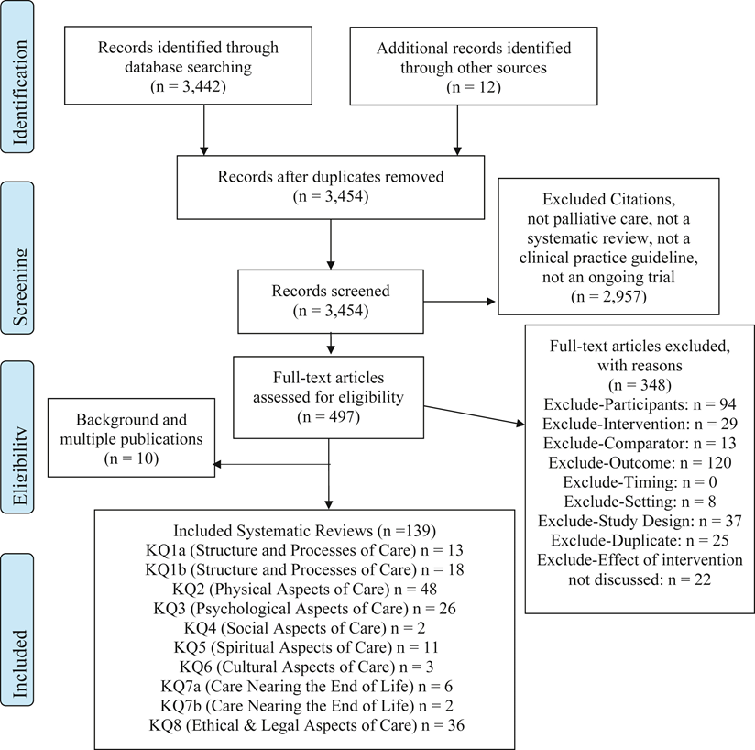
Systematic Review of Research Evidence
Conducted by Rand Evidence-based Practice Center with Technical Expert Panel (TEP)
Complete findings published: Journal of Pain and Symptom Management
  https://www.jpsmjournal.com/article/S0885-3924(18)30468-8/fulltext
Funded by:
  Gordon and Betty Moore Foundation
  Gary and Mary West Foundation
  The John A. Hartford Foundation
  Stupski Foundation
Notes:
As previously mentioned, a systematic review of the research evidence was added to the project scope for the 4th edition which had not been previously done in prior editions.
The diagram on the right provides a high-level overview of the systematic review process and outcomes of the evidence of the 10 key questions that were established.
The systematic review was conducted by the Rand Evidence-based Practice Center with guidance from a Technical Expert Panel that represented the NCP.
The complete findings of the systematic review are published in the Journal of Pain and Symptom Management and available at the URL noted on the slide.
Funding for the systematic review was provided collectively by four foundations:
Gordon and Betty Moore Foundation
Gary and Mary West Foundation
The John A. Hartford Foundation
Stupski Foundation

Slide 32
Practice Examples
Notes:
[NOTE to speakers: please feel free to change out practice examples as need and include ones from the 4th edition that best represent the target audience of your presentation.]
Now, would like to highlight several specific practice examples that are included in the 4th edition.

Slide 33

Practice Example: Long-Term Care Setting
A long-term care setting is incorporating palliative care
Physician assistant and social worker lead efforts to improve advance care planning and completion of formal directives.
Varying levels of decision-making capacity pose a challenge to completing advance directives
Staff need help determining capacity
Facility develops a consultative relationship with a hospital-based palliative care team and ethics consult service
Notes:
This practice example focuses on a long-term care setting. A long-term care setting is incorporating palliative care for patients in its day center, residential care, and long-term care programs. A physician assistant and social worker lead efforts to improve advance care planning and completion of formal directives. Varying levels of decision-making capacity pose a challenge to completing advance directives, and staff need help determining capacity. The facility develops a consultative relationship with a hospital-based palliative care team and ethics consult service for education on determination of capacity and help with challenging scenarios.

Slide 34

Practice Example: Community Hospital
Staff at a community hospital identify a trend re: after hours and weekend utilization of the ED with seriously ill children following a hospitalization
Local hospice has a large home-based pediatric palliative and hospice program, with just one board-certified hospice and palliative medicine pediatrician.
Hospital’s pediatric service partners with a large community pediatric practice and the hospice pediatric physician, to implement a collaborative QI initiative.
Notes:
This practice example focuses on a community hospital. Staff at a community hospital identify a trend in after hours and weekend utilization of the emergency department (ED). A significant proportion of patients they see are seriously ill children with symptom issues following a hospitalization at the pediatric hospital, which is 30 miles away. The local hospice has a large home-based pediatric palliative and hospice program, with just one board-certified hospice and palliative medicine pediatrician. The hospital’s pediatric service partners with a large community pediatric practice and the hospice pediatric physician, to implement a collaborative quality improvement initiative. Outcomes include staff education for hospital ED personnel, the development of decision-support tools for symptom management, processes to clarify after-hours access to specialty palliative care, and a community resources guide specifically for families with seriously ill children.

Slide 35

Practice Example: Rural Palliative Care
A rural palliative care program provides care in patients’ homes
Staff is often alone on visits
Team members stressed with ethical issues (ie requests for physician aid-in-dying, family conflicts)
Program develops an online ethics forum for staff education
Provides educational podcasts for team members
Leadership facilitates dual visits of the practitioners and social workers to facilitate greater support
Notes:
This practice example focuses on a rural palliative care. A rural palliative care program provides care in patients’ homes across a large geographic area. The staff is often alone on these visits and sometimes do not see other team members for several days at a time. Team members express stress with some of the ethical issues they confront, particularly when patients have impaired decision-making, when they receive requests for physician aid-in-dying, and when there are family conflicts. The program develops an ethics forum for education, discussion of challenging cases, and identification of practical measures for support. The forum is hosted online, so staff can either listen in or see each other via the computer. The program provides educational podcasts for team members. Leadership facilitates dual visits of the practitioners and social workers to help with challenging cases, and facilitate greater professional and team support.

Slide 36
Next Steps
Notes:
Now, let’s discuss next steps for you to apply and integrate the guidelines in your practice setting.

Slide 37
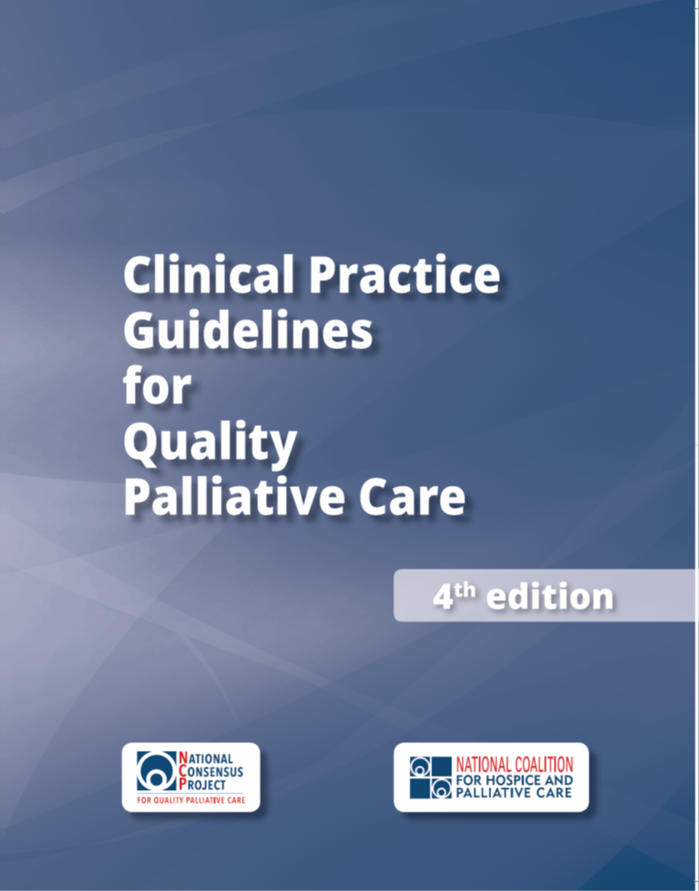
Read the Guidelines
Available at:
www.nationalcoalitionhpc.org/ncp
PDF
E-PUB
ONLINE
PURCHASE
Notes:
First step, of course, is to read the guidelines.
The guidelines are available to access in four different formats:
Download the PDF version (at no cost)
Download the E-PUB version for your tablet or phone (at no cost)
View the online version to access and/or print individual domains and practice examples as well as search for specific content (at no cost)
Purchase print copy/copies

Slide 38
Implement the Guidelines
Share the NCP Guidelines with your team and colleagues
Assess strengths, gaps and opportunities in your practice setting to apply the NCP Guidelines
Develop a plan to improve care for your patients with serious illness and their families/caregivers
Begin with easily attainable goals, and plan to grow and scale
Celebrate achievements
Notes:
These are a few high-level suggestions to implement the guidelines in your practice setting.
Share the NCP Guidelines with your team and colleagues
Use the guidelines as an opportunity to assess strengths, gaps and opportunities in your practice setting to apply the NCP Guidelines. Specifically, assess/acknowledge how your team has already implemented or currently implementing components of the Guidelines into your program? And, what can your team do differently in light of the new Guidelines?
Develop a quality improvement plan to improve the care and services for your patients with serious illness and their families/caregivers
To attain quick success, begin with easily attainable goals, and plan to grow and scale from there.
Celebrate achievements along the way with your team and acknowledge those achievements to your leadership.
[NOTE to speakers: adapt implementation strategies according to your target audience for your presentation.]

Slide 39

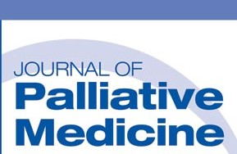
Communication Resources
Available at www.nationalcoalitionhpc.org/ncp
NCP in the News: Online articles
Press Release
FAQs
Blog Post
NCP Stakeholder Summit Report
About and History of the NCP
Notes:
Communication resources about the NCP Guidelines, 4th edition, are available to access/download on the NCP website (note the URL noted on the slide) that includes:
NCP in the News - which links to online articles about the guidelines that are published in health-related journals such as Health Affairs and Journal of Palliative Medicine
Press release - that was distributed to the media
FAQ document - that provides key information and messages about the 4th edition
Blog post - authored by the NCP Steering Committee Co-Chairs: Drs Martha Twaddle and Betty Ferrell
Summary report of the NCP Stakeholder Strategic Directions Summit - that launched the development of the 4th edition
And, more information about the National Consensus Project for Quality Palliative Care

Slide 40
For More Information
Visit: www.nationalcoalitionhpc.org/ncp
Follow: @coalitionhpc (#NCPGuidelines)
Contact: info@nationalcoalitionhpc.org
Notes:
For more information, visit the NCP website at the url noted on the slide and follow @coalitionhpc (#NCP Guidelines) on twitter for ongoing updates. Specific questions can be emailed to info@nationalcoalitionhpc.org.

