Slide 1

Clinical Practice Guidelines for Quality Palliative Care,
4th edition: Pediatric Highlights

Slide 2
Objectives
Describe palliative care provision for patients with serious illness.
Discuss the 4th edition of the National Consensus Project’s Clinical Practice Guidelines for Quality Palliative Care (NCP Guidelines) domains and pediatric content.
Identify strategies to incorporate the NCP Guidelines, 4th Edition criteria into one’s own clinical practice.

Slide 3
What is Palliative Care?

Slide 4
Palliative Care Definition
Interdisciplinary care delivery system designed for patients, their families and caregivers
Beneficial at any stage of a serious illness
Anticipates, prevents, and manages physical, psychological, social, and spiritual suffering to optimize quality of life
Delivered in any care setting through the collaboration of many types of care providers
Improves quality of life for both the patient and the family through early integration into the care plan
- National Consensus Project for Quality Palliative Care

Slide 5

Key Concepts
Person-and family-centered approach to care
Inclusive of all people living with serious illness, regardless of setting, diagnosis, age or prognosis
A responsibility of all clinicians and disciplines caring for people living with serious illness

Slide 6

Serious Illness
A health condition that carries a high risk of mortality and either negatively impacts a person’s daily function or quality of life or excessively strains their caregiver.*
*Kelley, AS, Bollens-Lund, E. Identifying the population with serious illness: the “denominator” challenge. Journal of Palliative Medicine. Volume: 21 Issue S2: March 1, 2018.
Notes:
This is the definition of ‘Serious Illness’ that is used in the 4th edition of the NCP Guidelines that was published by Drs. Kelly and Bollens-Lund.

Slide 7
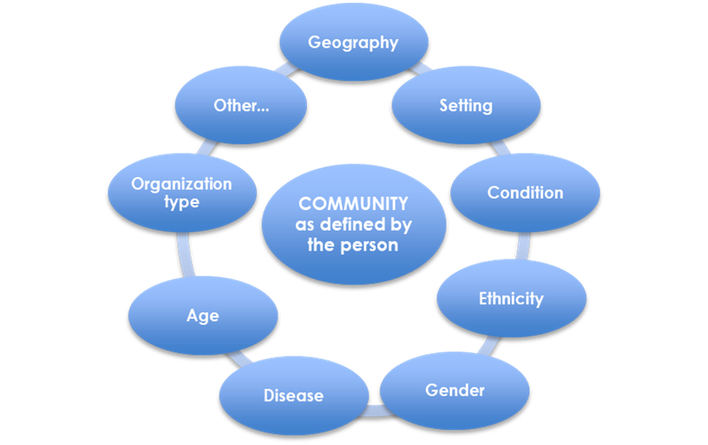
Community is Person-Centric
“Community” is defined:
  by the person living with serious illness
  as a lens through which their needs are assessed
- National Consensus Project Strategic Directions Summit June 2017
Notes:
One of the strategic outcomes of the National Stakeholder Summit that was held in June 2017 before the actual writing of the 4th edition began, was the person-centric definition of community that was established. “Community” in the context of the NCP Guidelines is defined by the person; however, needs can change based on the setting of care and other factors (e.g. in the ICU, home, etc.). It is also helpful to define community as a lens through which people’s needs can be assessed. Community is person-centric and should not be “medicalized.”

Slide 8
Guidelines Background & Process

Slide 9
Why Clinical Practice Guidelines?
Guidelines improve care and safety for patients and families:
  Defines structures and processes of care
  Sets expectations for providers
  Guides clinical decision making
  Promotes standardization
  Creates a foundation for accountability
Guidelines provide the essential elements for standards, policies and best practices

Slide 10


National Consensus Project for Quality Palliative Care (NCP)
Began in 2001 to define and improve the delivery of palliative care
Stakeholder involvement expanded over the last decade
Three prior editions of the NCP Guidelines published: 2004, 2009, 2013
National Coalition for Hospice and Palliative Care serves as organizational home of NCP
Notes:
The National Consensus Project for Quality Palliative Care (NCP) began in 2001 with a task force of five key national organizations and content experts. The purpose of the NCP is to further define and underscore the value of palliative care, and improve upon the delivery of palliative care in the United States. The NCP expanded over that last decade to include more national organizations and stakeholders. Three prior editions of the NCP Guidelines were published in 2004, 2009, and 2013. The National Coalition for Hospice and Palliative Care serves as the organizational home of the NCP.

Slide 11
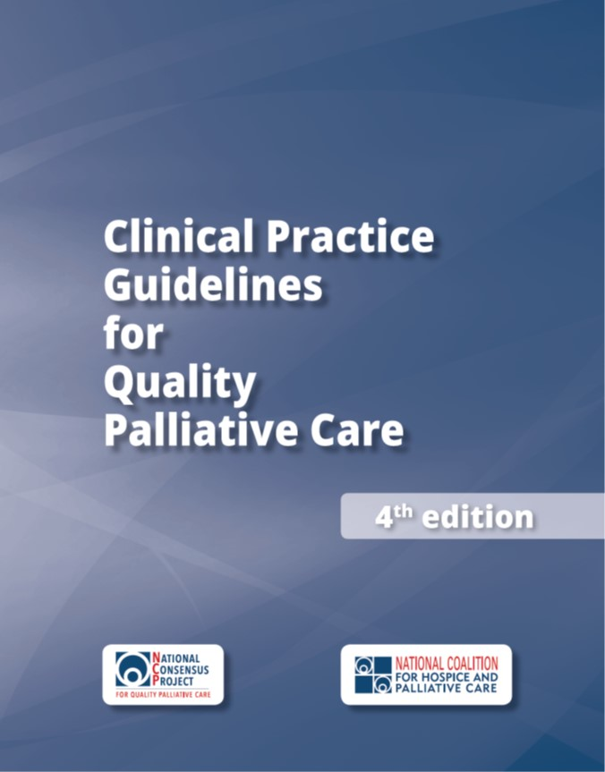
The 4th edition
For all people with serious illness, regardless of setting, diagnosis, prognosis, or age
Funded by the Gordon and Betty Moore Foundation
Published by the National Coalition for Hospice and Palliative Care
NCP leadership consisted of 16 national organizations
Notes:
The 4th edition of the NCP Guidelines was greatly expanded to improve access to quality palliative care for all people with serious illness, regardless of setting, diagnosis, prognosis, or age. This edition is for all clinicians who care for seriously ill patients, and not just for palliative care specialists. The 4th edition provides the essential elements of what all clinicians (specialists and primary care) can do to provide quality palliative care. The development and dissemination of this edition was funded by the Gordon and Betty Moore Foundation and published by the National Coalition for Hospice and Palliative Care. The leadership for the 4th edition consisted of 16 national organizations in addition to the Coalition staff and the NCP writer/editor.

Slide 12















NCP Leadership Organizations
National Pediatric Hospice and Palliative Care Collaborative
Notes:
These are the 16 national organizations who provided the leadership of the National Consensus Project to develop the 4th edition. Note the National Pediatric Hospice and Palliative Care Collaboration was one of the 16. Each organization provided representatives to serve on the NCP Steering Committee and NCP Writing Workgroup. Dr. Sarah Friebert was the pediatric representative on the Steering Committee and Dr. Kathie Kobler served on the Writing Workgroup. Dr. Tammy Kang served on the Systematic Review Committee, which operated in parallel.

Slide 13
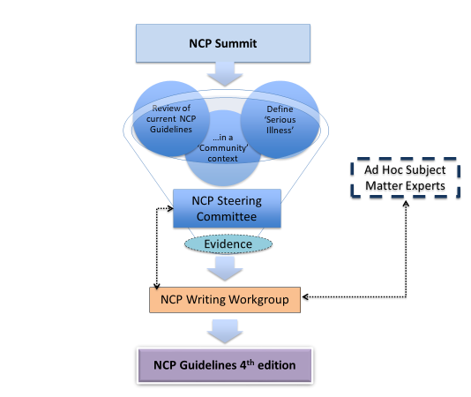
National Consensus Project Process (2017-18)
Development:
  Steering Committee and Writing Workgroup formed
  NCP Strategic Directions Stakeholder Summit held
  Writing > reviews > revisions > approvals > consensus achieved
Systematic review of research evidence:
  Completed by the RAND Evidence-based Practice Center
Endorsements:
  Received from more than 80 national organizations
Publication: October 31, 2018
Notes:
This slide provides a visual overview of how the 4th edition was developed. Interesting to note, the original goal and intent was to develop guidelines for community-based palliative care. When this project was officially launched with a National Stakeholder Strategic Directions Summit, a key decision was made have one unified set of guidelines that would serve to improve quality palliative care for all people living with serious illness regardless of setting, age, diagnosis, or prognosis.
From that point, the actual writing, reviews, revisions, approval, and consensus process was a year-long effort.
Also, a systematic review of the research evidence was added to the original project scope and conducted by the RAND corporation that will be highlighted later in this presentation.
Before the guidelines were published, more than 80 national organizations endorsed the guidelines which are listed in the Appendix section of the guidelines and on the NCP website.
The 4th edition was officially published on Oct. 31, 2018.

Slide 14
4th Edition: Domains & Content

Slide 15
Domains of Palliative Care
Domain 1: Structure and Processes of Care
Domain 2: Physical Aspects of Care
Domain 3: Psychological and Psychiatric Aspects of Care
Domain 4: Social Aspects of Care
Domain 5: Spiritual, Religious, and Existential Aspects of Care
Domain 6: Cultural Aspects of Care
Domain 7: Care of the Patient Nearing the End of Life
Domain 8: Ethical and Legal Aspects of Care

Slide 16

Key Themes: the 6 C’s
Each domain addresses:
  Comprehensive assessment
  Care coordination
  Care transitions
  Caregiver needs
  Cultural inclusion
  Communication
Notes:
The 4th edition was expanded to address the following key themes (the 6 C’s) that were integrated into all eight domains:
• The elements of a comprehensive assessment are described;
• Family caregiver assessment, support, and education are referenced;
• The essential role of care coordination, especially during care transitions, is emphasized;
• Culturally inclusive care is referenced in all the domains and expanded in the Cultural Aspects of
Care domain; and
• Communication (within the palliative care team, with patients and families, with other clinicians, and with community resource providers) is a prerequisite for delivery of quality care for the seriously ill and is emphasized throughout.

Slide 17

Domain 1: Structure and Processes of Care
Principles and practices can be integrated into any health care setting
Delivered by all clinicians and supported by palliative care specialists who are part of an interdisciplinary team (IDT)
Begins with a comprehensive assessment and emphasizes:
  Patient and family engagement
  Communication
  Care coordination
  Continuity of care across health care settings
Notes:
Now will provide an overview of each domain in the 4th edition and what’s new from the 3rd edition. (SEE SPEAKER NOTES RE: KEY REVISIONS IN EACH DOMAIN SLIDE)
Domain 1: Structures and Processes of Care states that palliative care principles and practices can be integrated into any health care setting, delivered by all clinicians and supported by palliative care specialists who are part of an interdisciplinary team (IDT) with the professional qualifications, education, training, and support needed to deliver optimal patient- and family-centered care. Palliative care begins with a comprehensive assessment and emphasizes patient and family engagement, communication, care coordination, and continuity of care across health care settings.
Key revisions in Domain 1: Structures and Processes of Care include:
Coordination of care is emphasized as an important element of care, especially when patients receive community-based palliative care. New content regarding the need for ongoing sustainability is included.

Slide 18
Domain 1: Pediatric Highlights
Criteria 1.2.6 - For peds patients, the team ascertains the developmental status and child’s or teen’s understanding of their disease, as well as parental preferences for their child’s care at the time of initial consultation. This is revisited throughout the trajectory of care.
Guideline 1.8 – Emotional support to the Interdisciplinary Team
  Criteria 1.8.1 – The program assesses staff for distress and grief
  Criteria 1.8.3 – The IDT implements interventions to promote staff support and sustainability…

Slide 19

Domain 2: Physical Aspects of Care
Begins with understanding patient goals in the context of physical, functional, emotional, and spiritual domains
Focuses on relieving symptoms and improving or maintaining functional status and quality of life
Emphasizes symptom management that encompasses pharmacological, non-pharmacological, interventional, behavioral, and complementary treatments
Is accomplished through collaboration among all professionals involved in the patients’ care across all care settings

Slide 20
Domain 2: Pediatric Highlights
Criteria 2.2.3 – (Assessment) The IDT utilizes validated symptom and functional assessment tools, treatment policies, standards and guidelines appropriate to the care of neonates, children, adolescents, and adults with serious illness
Criteria 2.3.5 – (Treatment) The IDT collaborates with appropriate specialists, including child life specialists, when meeting the symptom management needs of neonatal and pediatric patients

Slide 21
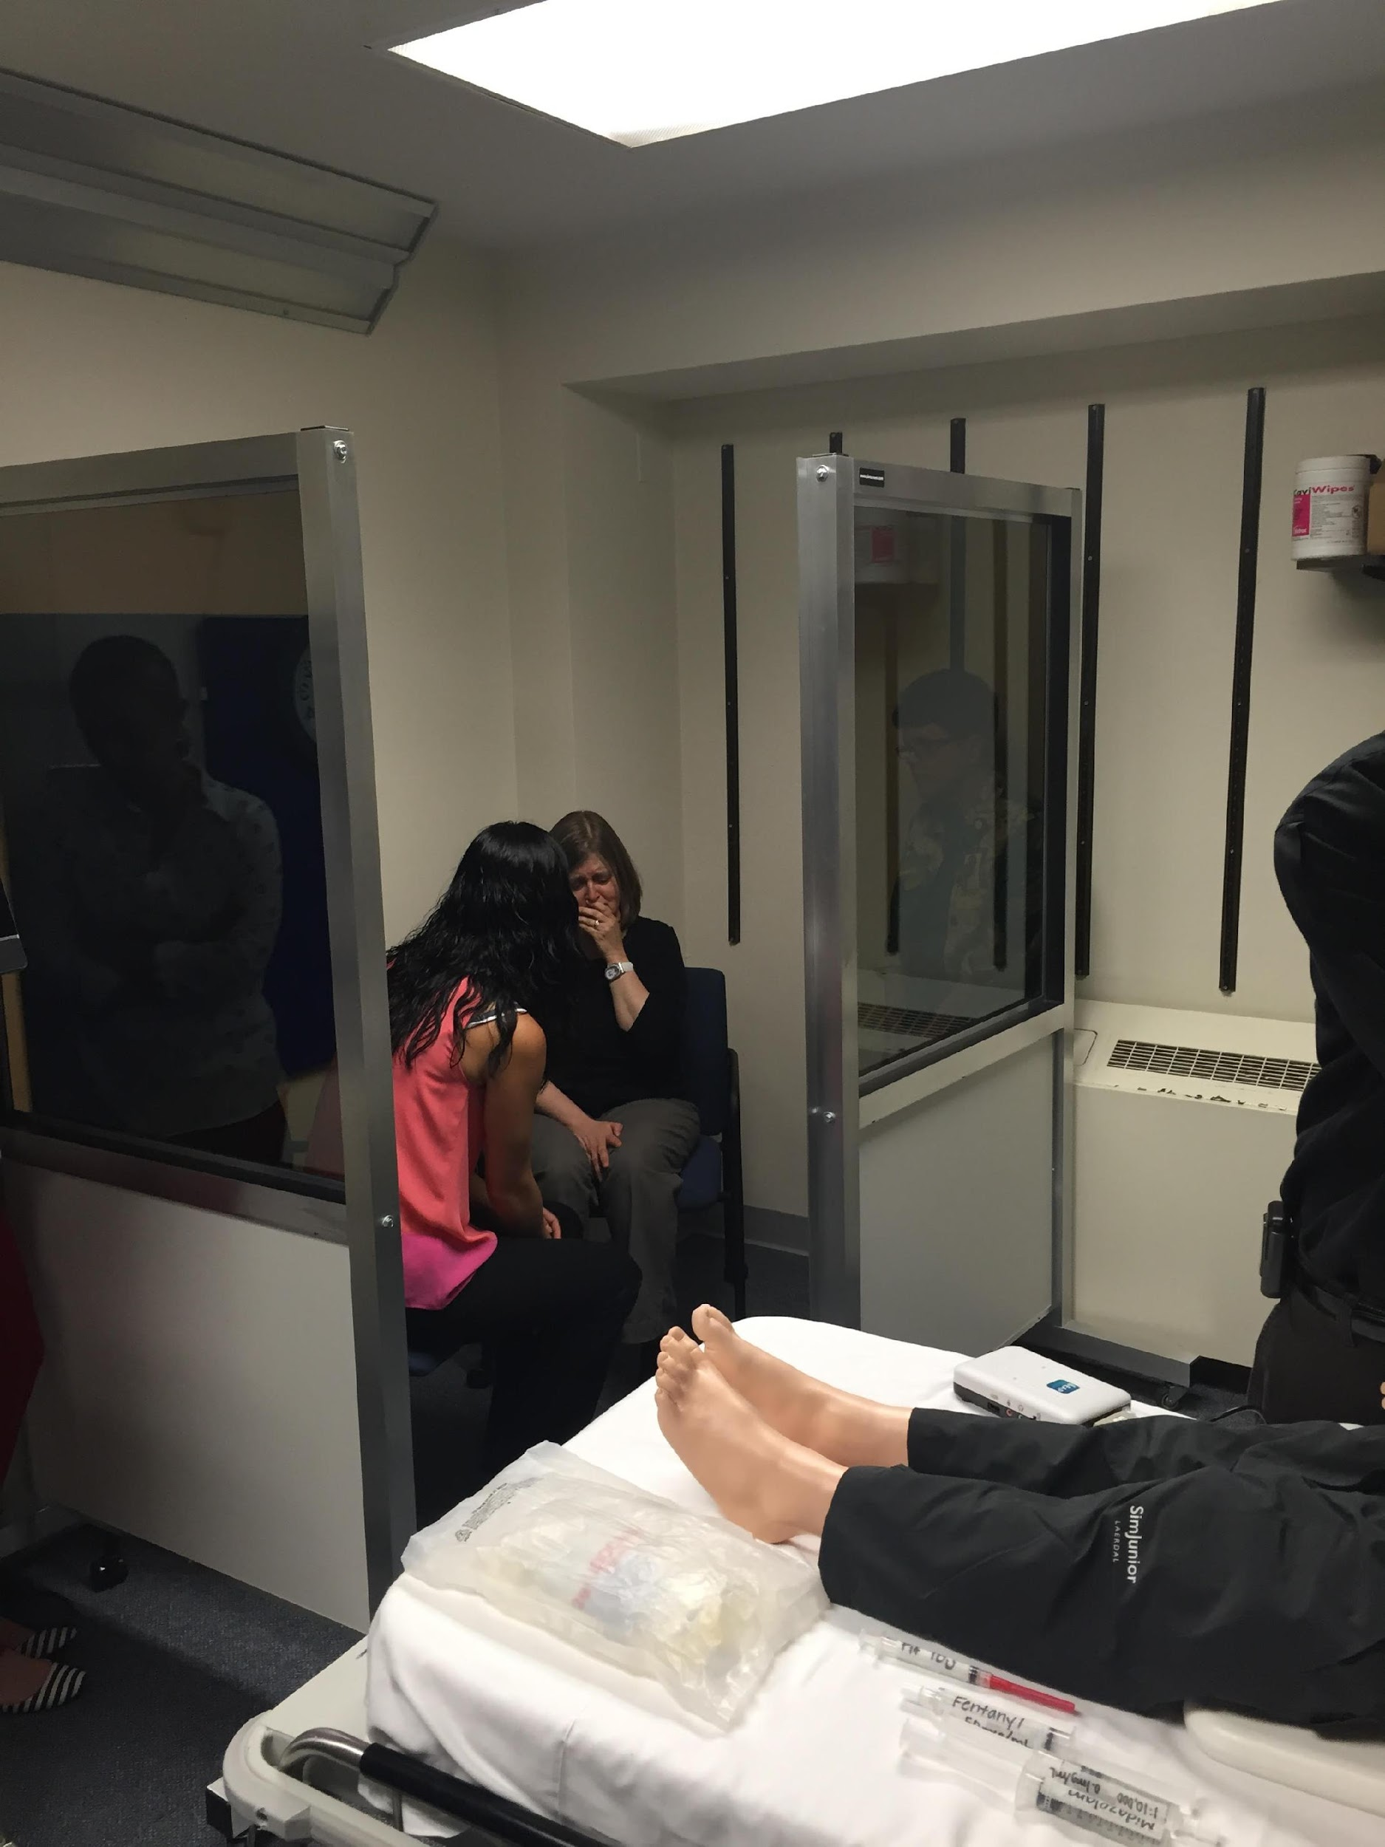
Domain 3: Psychological and Psychiatric Aspects of Care
IDT addresses psychological and psychiatric aspects of care in the context of serious illness
IDT conducts comprehensive developmentally and culturally-sensitive mental status screenings
Social worker facilitates mental health assessment and treatment in all care settings
IDT communicates to the patient and family the implications of psychological and psychiatric aspects of care

Slide 22
Domain 3: Pediatric Highlights
Criteria 3.2.3 – (Assessment) The IDT assesses the full spectrum of how the patient and family, including parents and siblings, are coping with serious illness
Criteria 3.3.3 – (Treatment) Child and adolescent patients and family members receive care to address their mental health needs from child life specialists, integrative therapy professionals, and emotional or mental health services for pediatric patients
Criteria 3.3.5.g – (Treatment) Child, parent, and sibling psychological and mental health support throughout the trajectory of care, including times of significant shift in a patient’s baseline

Slide 23

Domain 4: Social Aspects of Care
Addresses environmental and social factors that affect patients and their families
Social determinants of health have a strong influence on care outcomes
IDT partners with the patient and family to identify strengths and address needs
Social worker is essential to the IDT

Slide 24
Domain 4: Pediatric Highlights
Criteria 4.1.3 – (Global) Palliative care teams serving perinatal and pediatric patients have expertise in meeting the needs of neonates, children, and adolescents living with serious illness. Expertise is also needed to support siblings, as well as parents in their role as care providers and decision makers for their children.
Criteria 4.2.3 – (Assessment) The social assessment includes changes in patient or family members’ school enrollment, employment or vocational roles, recreational activities, and economic security

Slide 25

Domain 5: Spiritual, Religious, and Existential Aspects of Care
Spirituality is recognized as a fundamental aspect of palliative care
Dynamic aspect through which individuals seek meaning, purpose, and transcendence, and experience relationships
Expressed through beliefs, values, traditions, and practices
IDT serves in a manner that respects
  all spiritual beliefs and practices, and
  when patients and families decline to discuss their beliefs or accept support

Slide 26
Domain 5: Pediatric Highlights
Criteria 5.1.5 – (Global) Care of children, adolescents, and their family members recognizes that spirituality is integral to coping with serious illness and is provided in a developmentally-appropriate manner.
Criteria 5.3.5 – (Treatment) Palliative care teams serving pediatric patients have expertise in honoring and meeting the spiritual needs of children and adolescents, including in situations where children or adolescents have differing values, beliefs, and needs from their parents or designated decision makers.

Slide 27
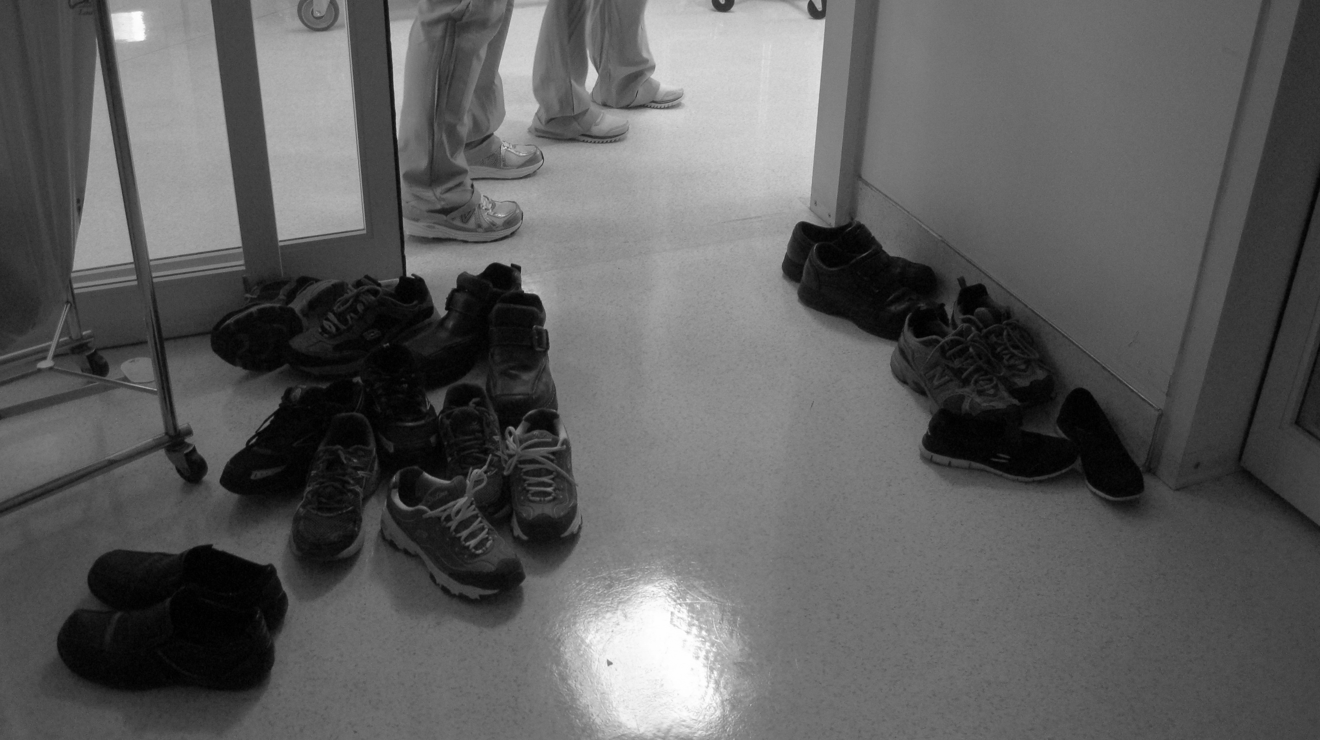
Domain 6: Cultural Aspects of Care
First step is assessing and respecting values, beliefs and traditions
Care plans incorporate culturally- sensitive resources and strategies
Respectful acknowledgment and culturally-sensitive support for grieving practices is provided
IDT members continually expand awareness of their own biases and perceptions

Slide 28
Domain 6: Pediatric Highlights
Criteria 6.3.3 – When the patient is a child or adolescent, the IDT assessment includes:
  The role of the child or adolescent in the family
  Whether parents share information about important matters with their child(ren), including siblings and foster children
  How parents define being a good parent, and how that impacts medical decision making
  Whether the family’s culture permits parents to make decisions for their minor or if medical decision-making authority is deferred to religious or cultural leaders
  The meanings attributed by the minor and family regarding how and why the illness occurred and childhood suffering and death
  When serious illness is diagnosed in utero (perinatal), the meaning of the pregnancy and childbirth practices are valued in the parents’ culture(s)

Slide 29
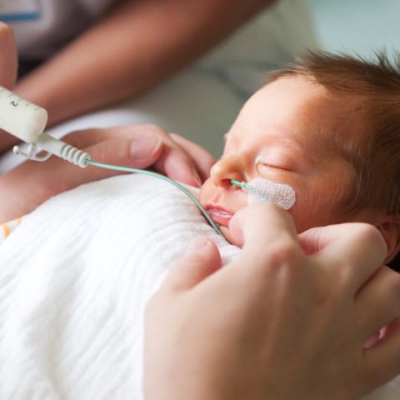
Domain 7: Care of the Patient Nearing the End of Life
Highlights care provided to patients and their families near the end of life
Particular emphasis on the days leading up to and just after the death of the patient
Comprehensive assessment and management of physical, social, spiritual, psychological, and cultural aspects of care are critically important near death
IDT provides developmentally-appropriate education to patient, family and others

Slide 30

Domain 7: Care of the Patient Nearing the End of Life (cont.)
Interdisciplinary model of hospice care is recognized as the best care for patients nearing the end of life
Early access to hospice support should be facilitated whenever possible to optimize care outcomes
Palliative care teams, hospice providers and other healthcare organizations must work together to find solutions for all patients and families in their final months of life

Slide 31
Domain 7: Pediatric Highlights
Criteria 7.1.1.m – Assessing and addressing the needs of children or adolescents facing the loss of a family member, including custody arrangements as needed, and coordinating with perinatal and pediatric grief specialists as needed
Criteria 7.5.7 – Grieving children are referred to pediatric grief specialists, programs, and camps based on their age and needs

Slide 32

Domain 8: Ethical and Legal Aspects of Care
IDT applies ethical principles to the care of patients with serious illness, including honoring patient preferences, and decisions made by surrogates
Surrogates’ obligations are to represent the patient’s preferences or best interests
Familiarity with local and state laws is needed relating to:
  Advance care planning
  Decisions regarding life-sustaining treatments
  Evolving treatments with legal ramifications (eg, medical marijuana)

Slide 33

Domain 8: Pediatric Perspectives
Criteria 8.1.12 – (Global) Ensuring IDT sustainability and avoiding clinician burnout is considered an ethical obligation in all care settings to preserve team members’ health and ability to remain engaged in palliative care.

Slide 34
Domain 8: Pediatric Perspectives
Criteria 8.2.3 – (Legal Considerations) Attention is paid to the rights of children and adolescents in decision making, as well as applicable statutes.
Criteria 8.3.7 – (Assessment) When caring for pediatric patients with serious illness, the child’s or adolescent’s views and preferences for medical care, including assent for treatment (when developmentally appropriate), are assessed, documented, and given appropriate weight in decision making.

Slide 35
Domain 8: Pediatric Perspectives (cont.)
Criteria 8.4.5 – (Ongoing Decision Making) Children receive open, honest, developmentally-appropriate information about their serious illness and treatment options, and are given the opportunity to participate in decision making according to their wishes, age, and developmental capacity. When the child’s wishes differ from those of the adult decision maker, staff is available to assist the child and family work towards a resolution, prioritizing fidelity to the patient.

Slide 36
Domain 8: Pediatric Perspectives (cont.)
Criteria 8.4.6 – (Ongoing Decision Making) When parents or legal decision makers express a strong preference for non-disclosure of a poor prognosis to a seriously ill child or adolescent, the IDT assesses family motivations and values regarding truth-telling practices and preferences. While it is sometimes ethically permissible to defer to family values regarding nondisclosure of prognosis, clinicians work collaboratively with the family to meet the child or adolescent’s individual needs while respecting the parent or decision makers’ expectations and boundaries.

Slide 37
4th edition: Publication

Slide 38
Anatomy of a Domain: Example 1
Bleed tabs for easy access
Expanded introductions
Words bolded in red are defined in the Glossary
Temporal organization
Numbered items
Notes:
Using Domain 1 as an example, all eight domains include the following:
Each has an expanded introduction and
Each guideline and their corresponding criteria are numbered for easy referencing.
The publication also includes bleed tabs on the right side of their corresponding section for easy access and referencing.

Slide 39
Anatomy of a Domain: Example 2
Clinical implications
Operational implications
Application for ALL clinicians
Key research evidence overview
Notes:
Each domain includes clinical and operational implications – as well as essential skills needed by all clinicians.
An overview of the key research evidence from the systematic review is also highlighted in each domain.

Slide 40
Anatomy of a Domain: Example 3
Diverse practice examples
Notes:
Another new feature of the 4th edition is that each domain includes several practice examples of how the guidelines can be specifically applied and integrated. The practice examples showcase a variety of settings, clinicians and patient populations. This specific practice example focuses on a federally qualified health center and how nurse ‘navigators’ - with increased palliative care skills - can screen for unmet needs in all the domains of care in the NCP Guidelines. The navigators can also serve as contacts to enhance coordination of care and facilitate referrals with community home health and hospice services, as well as home-based primary care. Other practice examples will be discuss later in this presentation.

Slide 41
Additional Content
Notes:
Additional content is available is the Appendices of the 4th edition:
Appendix I is the glossary of key terms that are included in each domain. Throughout the guidelines, words are bolded in red that are defined in the Glossary.
Appendix II includes tools and resources associated with each domain.
Appendix III recognizes key contributors beyond the Steering Committee and Writing Workgroup.
Appendix IV is the scoping or literature review of each domain. Note, this not the systematic review which is published separately.
Appendix V recognizes the national organizations who endorsed and supported the guidelines prior to publication. An updated list of the endorsing organizations is available on the NCP website.

Slide 42
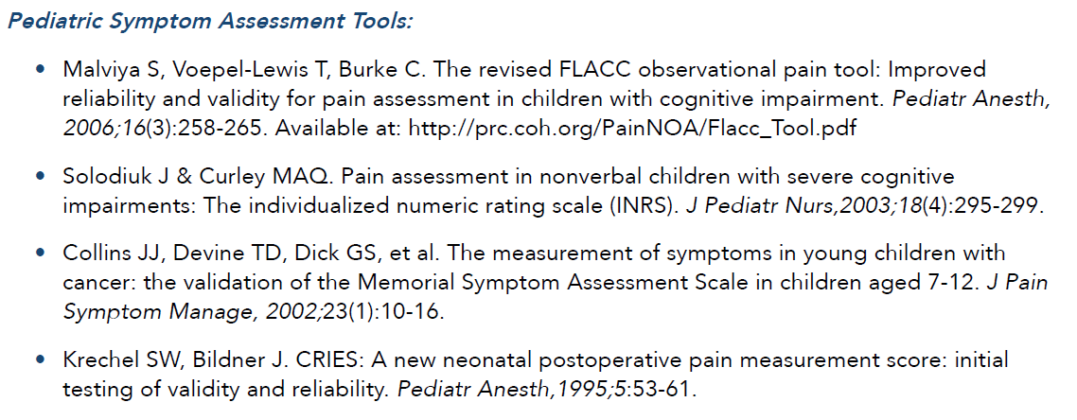
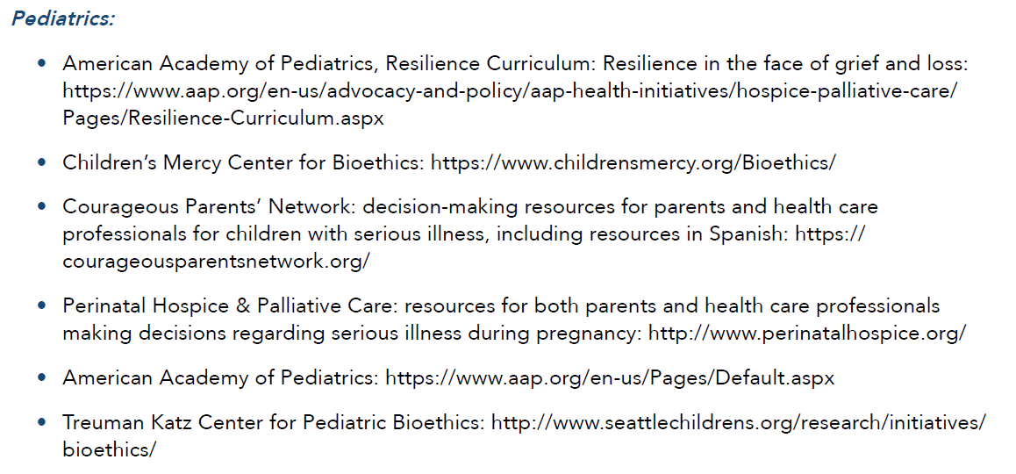
Pediatric Tools and Resources - Examples

Slide 43
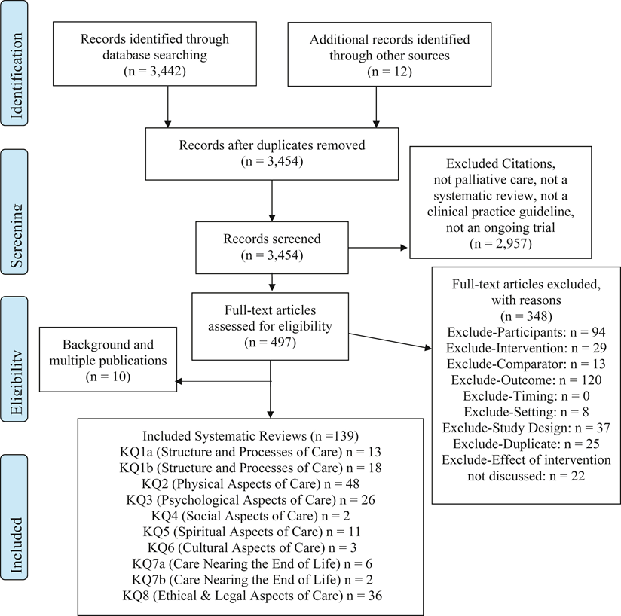
Systematic Review of Research Evidence
Conducted by Rand Evidence-based Practice Center with Technical Expert Panel (TEP)
Complete findings published: Journal of Pain and Symptom Management
  https://www.jpsmjournal.com/article/S0885-3924(18)30468-8/fulltext
Funded by:
  Gordon and Betty Moore Foundation
  Gary and Mary West Foundation
  The John A. Hartford Foundation
  Stupski Foundation
Notes:
As previously mentioned, a systematic review of the research evidence was added to the project scope for the 4th edition which had not been previously done in prior editions.
The diagram on the right provides a high-level overview of the systematic review process and outcomes of the evidence of the 10 key questions that were established.
The systematic review was conducted by the Rand Evidence-based Practice Center with guidance from a Technical Expert Panel that represented the NCP.
The complete findings of the systematic review are published in the Journal of Pain and Symptom Management and available at the URL noted on the slide.
Funding for the systematic review was provided collectively by four foundations:
Gordon and Betty Moore Foundation
Gary and Mary West Foundation
The John A. Hartford Foundation
Stupski Foundation

Slide 44
Pediatric Practice Examples

Slide 45

Practice Example: Community Hospital
Staff at a community hospital identify a trend re: after hours and weekend utilization of the ED with seriously ill children following a hospitalization
Local hospice has a large home-based pediatric palliative and hospice program, with just one board-certified hospice and palliative medicine pediatrician.
Hospital’s pediatric service partners with a large community pediatric practice and the hospice pediatric physician, to implement a collaborative QI initiative.
Notes:
See Practice Example D1-B. This practice example focuses on a community hospital. Staff at a community hospital identify a trend in after hours and weekend utilization of the emergency department (ED). A significant proportion of patients they see are seriously ill children with symptom issues following a hospitalization at the pediatric hospital, which is 30 miles away. The local hospice has a large home-based pediatric palliative and hospice program, with just one board-certified hospice and palliative medicine pediatrician. The hospital’s pediatric service partners with a large community pediatric practice and the hospice pediatric physician, to implement a collaborative quality improvement initiative. Outcomes include staff education for hospital ED personnel, the development of decision-support tools for symptom management, processes to clarify after-hours access to specialty palliative care, and a community resources guide specifically for families with seriously ill children.

Slide 46

Practice Example: Children’s Hospital
Pediatric palliative care team developed a collaborative practice with the pediatric oncology program.
Young girl with newly diagnosed metastatic cancers developed severe anxiety.
Team collaborated with child life specialists and pediatric clinical psychologist and used a combination of play, art and relaxation therapies along with medication.
Co-therapy sessions were facilitated to help child process feelings as disease advanced
Notes:
See Practice Example D3-D. This practice example focuses on a tertiary children’s hospital. A pediatric palliative care team at a tertiary children’s hospital developed a collaborative practice with the pediatric oncology program to optimize well-being of children throughout their cancer care trajectory. When a young girl with newly diagnosed metastatic cancer developed severe anxiety in the presence of clinicians, the palliative care team worked with the child and her parents to gain trust and assess the causes of her distress. The palliative team collaborated with child life specialists and the pediatric clinical psychologist to address the child’s anxiety, using a combination of play therapy, art therapy, relaxation techniques, and medication. The child’s mother played an integral role in helping the team to adjust strategies based on the child’s needs in the hospital, clinic, and home settings. Co-therapy sessions were facilitated to help the child and her identical twin process their feelings and anxiety as the disease advanced, providing opportunities for the child to identify and communicate what was most important to her at end of life.

Slide 47

Practice Example: Community Pediatric Palliative Care Team
A community pediatric palliative care team routinely assesses parental and child/adolescent preferences regarding goals of care.
A teen with advanced cancer disclosed to the team that he no longer wanted chemotherapy and was ready to die, but he did not want to disappoint or anger his parents.
The palliative team drew upon the expertise of their child life specialist, the teen’s oncology team at the hospital, along with the hospital’s pediatric ethics committee to facilitate a new plan that honored all family members’ needs.
Notes:
See Practice Example D8-F. A community pediatric palliative care team routinely assesses parental and child/adolescent preferences regarding goals of care, working to meet each family’s individualized communication and decision-making needs. A teen with advanced cancer disclosed to the team that he no longer wanted chemotherapy and was ready to die, but he did not want to disappoint or anger his parents. The palliative care team acknowledged the teen’s honest expression of his wishes and provided support. With his permission, the team coordinated goals of care discussions with the parents separately, and subsequently with the parents and teen together. The palliative team also drew upon the expertise of their child life specialist, the teen’s oncology team at the hospital, along with the hospital’s pediatric ethics committee to facilitate a new plan that honored all family members’ needs.

Slide 48
Next Steps

Slide 49
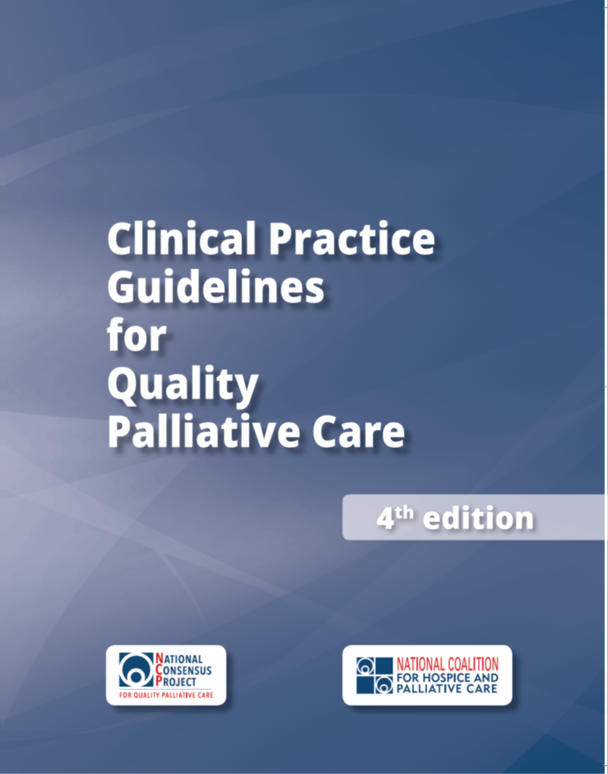
Read the Guidelines
Available at:
www.nationalcoalitionhpc.org/ncp
PDF
E-PUB
ONLINE
PURCHASE
Notes:
First step, of course, is to read the guidelines.
The guidelines are available to access in four different formats:
Download the PDF version (at no cost)
Download the E-PUB version for your tablet or phone (at no cost)
View the online version to access and/or print individual domains and practice examples as well as search for specific content (at no cost)
Purchase print copy/copies

Slide 50
Implement the Guidelines
Share the NCP Guidelines with your team and colleagues
Assess strengths, gaps and opportunities in your practice setting to apply the NCP Guidelines
Develop a plan to improve care for your patients with serious illness and their families/caregivers
Begin with easily attainable goals, and plan to grow and scale
Celebrate achievements
Notes:
These are a few high-level suggestions to implement the guidelines in your practice setting.
Share the NCP Guidelines with your team and colleagues
Use the guidelines as an opportunity to assess strengths, gaps and opportunities in your practice setting to apply the NCP Guidelines. Specifically, assess/acknowledge how your team has already implemented or currently implementing components of the Guidelines into your program? And, what can your team do differently in light of the new Guidelines?
Develop a quality improvement plan to improve the care and services for your patients with serious illness and their families/caregivers
To attain quick success, begin with easily attainable goals, and plan to grow and scale from there.
Celebrate achievements along the way with your team and acknowledge those achievements to your leadership.
[NOTE to speakers: adapt implementation strategies according to your target audience for your presentation.]

Slide 51

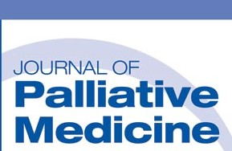
Communication and Education Resources
Available at www.nationalcoalitionhpc.org/ncp
NCP in the News: published articles
Press Release
FAQs
Blog Post
Ready-made PPT w/ speaker notes
On-demand webinar and handout
NCP Stakeholder Summit Report
About and History of the NCP
Notes:
Communication resources about the NCP Guidelines, 4th edition, are available to access/download on the NCP website (note the URL noted on the slide) that includes:
NCP in the News - which links to online articles about the guidelines that are published in health-related journals such as Health Affairs and Journal of Palliative Medicine
Press release - that was distributed to the media
FAQ document - that provides key information and messages about the 4th edition
Blog post - authored by the NCP Steering Committee Co-Chairs: Drs Martha Twaddle and Betty Ferrell
Summary report of the NCP Stakeholder Strategic Directions Summit - that launched the development of the 4th edition
And, more information about the National Consensus Project for Quality Palliative Care

Slide 52
For More Information
Visit: www.nationalcoalitionhpc.org/ncp
Follow: @coalitionhpc (#NCPGuidelines)
Contact: info@nationalcoalitionhpc.org
Notes:
For more information, visit the NCP website at the url noted on the slide and follow @coalitionhpc (#NCP Guidelines) on twitter for ongoing updates. Specific questions can be emailed to info@nationalcoalitionhpc.org.

